Slide 1
Introduction to Survival Analysis
Kristin Sainani Ph.D.
http://www.stanford.edu/~kcobb
Stanford University
Department of Health Research and Policy

Slide 2
Overview
What is survival analysis?
Terminology and data structure.
Survival/hazard functions.
Parametric versus semi-parametric regression techniques.
Introduction to Kaplan-Meier methods (non-parametric).
Relevant SAS Procedures (PROCS).

Slide 3
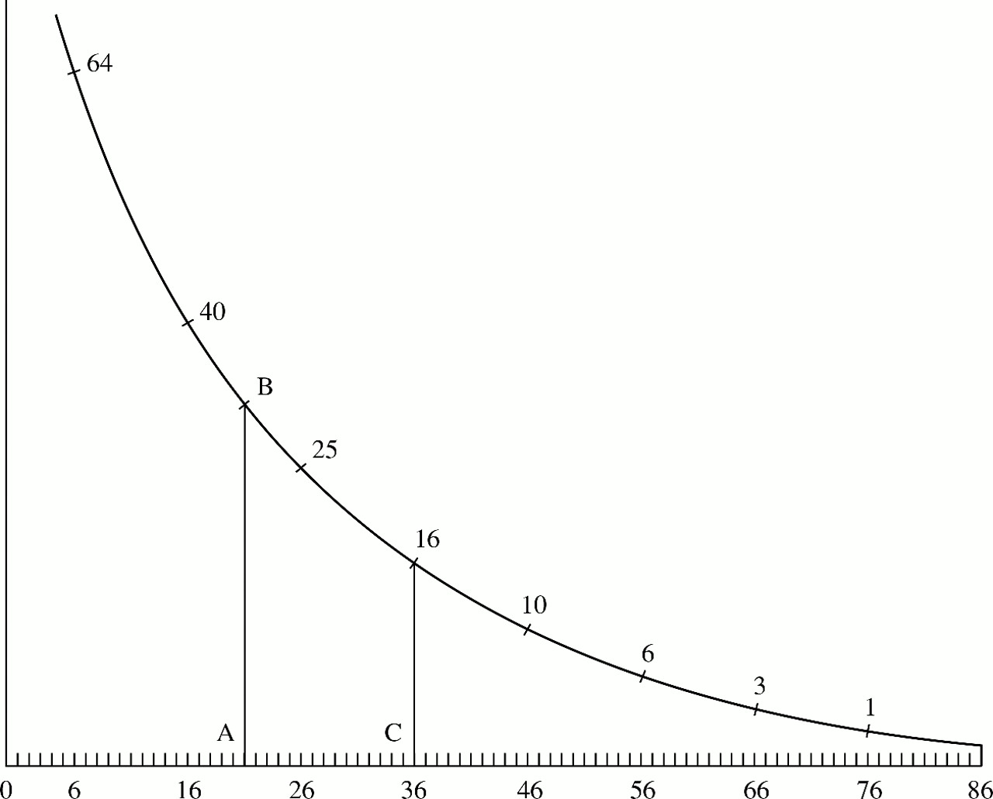
Early example of survival analysis, 1669
Christiaan Huygens' 1669 curve showing how many out of 100 people survive until 86 years.
From: Howard Wainer­ STATISTICAL GRAPHICS: Mapping the Pathways of Science. Annual Review of Psychology. Vol. 52: 305-335.

Slide 4
Early example of survival analysis
Roughly, what shape is this function?
What was a person’s chance of surviving past 20? Past 36?
This is survival analysis! We are trying to estimate this curve—only the outcome can be any binary event, not just death.

Slide 5
What is survival analysis?
Statistical methods for analyzing longitudinal data on the occurrence of events.
Events may include death, injury, onset of illness, recovery from illness (binary variables) or transition above or below the clinical threshold of a meaningful continuous variable (e.g. CD4 counts).
Accommodates data from randomized clinical trial or cohort study design.

Slide 6
Randomized Clinical Trial (RCT)
Disease
Intervention
Random assignment
Disease-free
Target population
Disease-free, at-risk cohort
Disease
Control
Disease-free
TIME

Slide 7
Randomized Clinical Trial (RCT)
Cured
Treatment
Random assignment
Not cured
Target population
Patient population
Cured
Control
Not cured
TIME

Slide 8
Randomized Clinical Trial (RCT)
Dead
Treatment
Random assignment
Alive
Target population
Patient population
Dead
Control
Alive
TIME

Slide 9
Cohort study (prospective/retrospective)
Disease
Exposed
Disease-free
Target population
Disease-free cohort
Disease
Unexposed
Disease-free
TIME

Slide 10
Examples of survival analysis in medicine

Slide 11
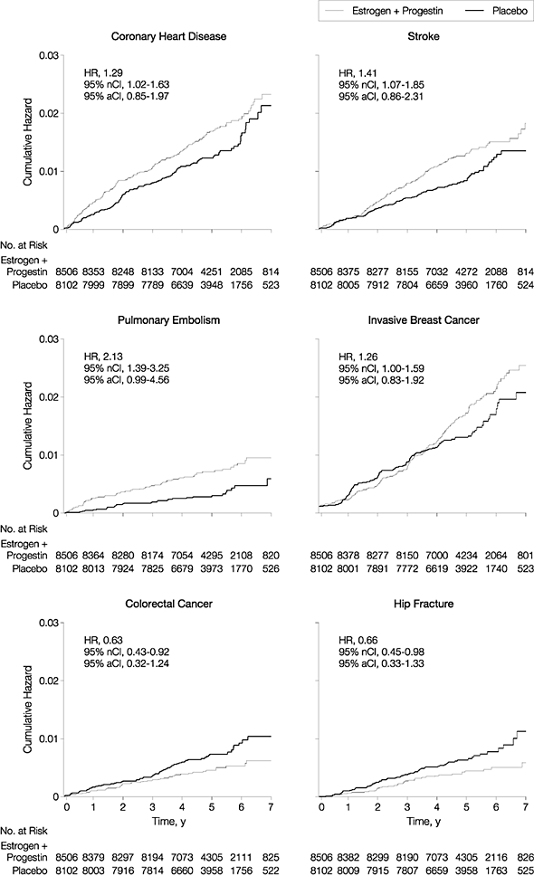
RCT: Women’s Health Initiative (JAMA, 2002)
On hormones
Cumulative incidence
On placebo
Women’s Health Initiative Writing Group. JAMA. 2002;288:321-333.

Slide 12
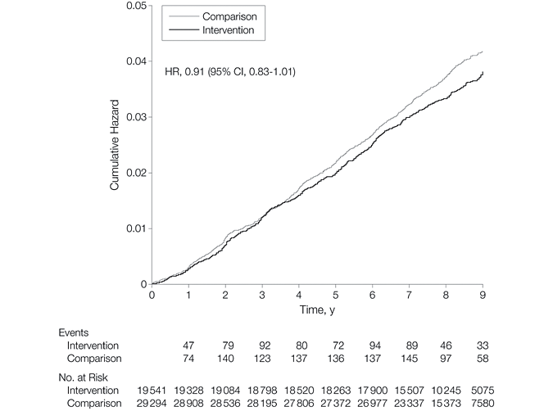
WHI and low-fat diet…
Control
Low-fat diet
Prentice et al. JAMA, February 8, 2006; 295: 629 - 642.

Slide 13
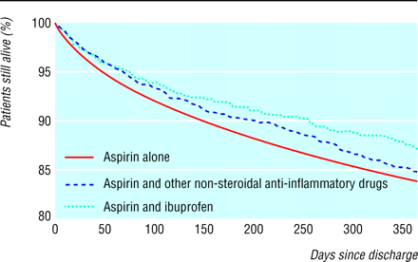
Retrospective cohort study:
From December 2003 BMJ:
Aspirin, ibuprofen, and mortality after myocardial infarction: retrospective cohort study
Curits et al. BMJ 2003;327:1322-1323.

Slide 14
Objectives of survival analysis
  Estimate time-to-event for a group of individuals, such as time until second heart-attack for a group of MI patients.
  To compare time-to-event between two or more groups, such as treated vs. placebo MI patients in a randomized controlled trial.
  To assess the relationship of co-variables to time-to-event, such as: does weight, insulin resistance, or cholesterol influence survival time of MI patients?
  Note: expected time-to-event = 1/incidence rate

Slide 15
Why use survival analysis?
1. Why not compare mean time-to-event between your groups using a t-test or linear regression?
-- ignores censoring
2. Why not compare proportion of events in your groups using risk/odds ratios or logistic regression?
--ignores time
Notes:
1. If no censoring (everyone followed to outcome-of-interest) than ttest on mean or median time to event is fine.
2. If time at-risk was the same for everyone, could just use proportions.

Slide 16
Survival Analysis: Terms
Time-to-event: The time from entry into a study until a subject has a particular outcome
Censoring: Subjects are said to be censored if they are lost to follow up or drop out of the study, or if the study ends before they die or have an outcome of interest. They are counted as alive or disease-free for the time they were enrolled in the study.
  If dropout is related to both outcome and treatment, dropouts may bias the results
Notes:
PhD candidates who are most likely to take longest may be most likely to drop out, thereby biasing results.

Slide 17
Data Structure: survival analysis
Two-variable outcome :
Time variable: t_{i} = time at last disease-free observation or time at event
Censoring variable: c_{i} =1 if had the event; c_{i} =0 no event by time t_{i}

Slide 18
Right Censoring (T>t)
Common examples
Termination of the study
Death due to a cause that is not the event of interest
Loss to follow-up
We know that subject survived at least to time t.

Slide 19
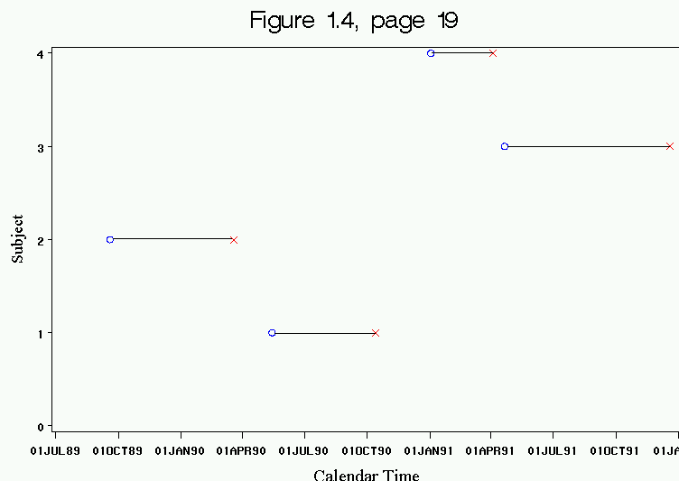
Choice of time of origin. Note varying start times.

Slide 20
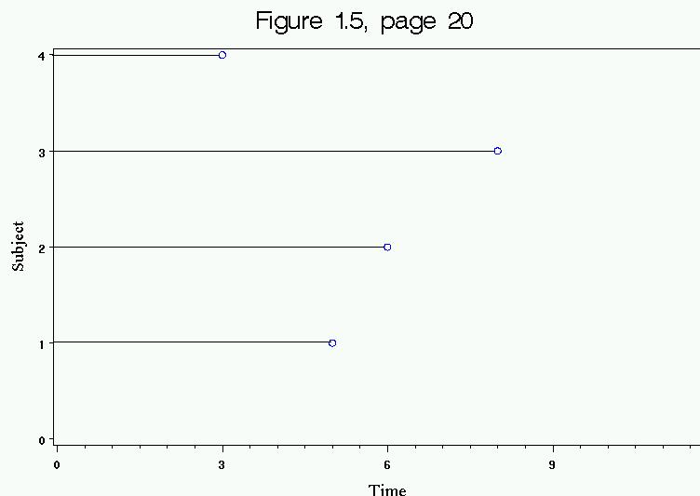
Count every subject’s time since their baseline data collection.
Right-censoring!

Slide 21
Introduction to survival distributions
T_{i} the event time for an individual, is a random variable having a probability distribution.
Different models for survival data are distinguished by different choice of distribution for T_{i.}

Slide 22
Describing Survival Distributions
Parametric survival analysis is based on so-called “Waiting Time” distributions (ex: exponential probability distribution).
The idea is this:
Assume that times-to-event for individuals in your dataset follow a continuous probability distribution (which we may or may not be able to pin down mathematically).
For all possible times T_{i} after baseline, there is a certain probability that an individual will have an event at exactly time T_{i}. For example, human beings have a certain probability of dying at ages 3, 25, 80, and 140: P(T=3), P(T=25), P(T=80), P(T=140). These probabilities are obviously vastly different.

Slide 23
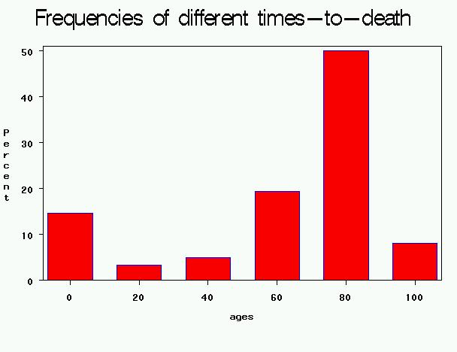
Probability density function: f(t)
In the case of human longevity, T_{i} is unlikely to follow a normal distribution, because the probability of death is not highest in the middle ages, but at the beginning and end of life.
Hypothetical data:
People have a high chance of dying in their 70’s and 80’s;
BUT they have a smaller chance of dying in their 90’s and 100’s, because few people make it long enough to die at these ages.

Slide 24
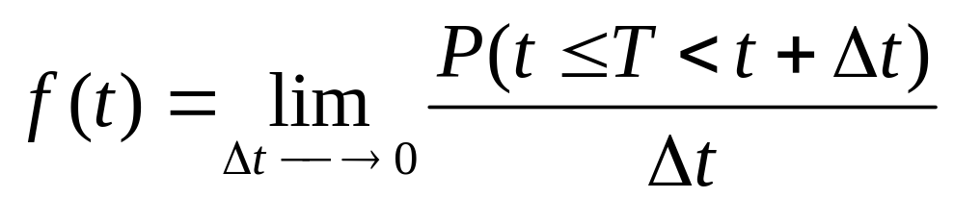
Probability density function: f(t)
The probability of the failure time occurring at exactly time t (out of the whole range of possible t’s).

Slide 25
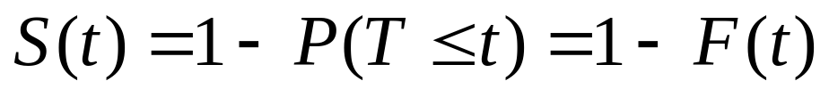
Survival function: 1-F(t)
The goal of survival analysis is to estimate and compare survival experiences of different groups.
Survival experience is described by the cumulative survival function:
F(t) is the CDF of f(t), and is “more interesting” than f(t).
Example: If t=100 years, S(t=100) = probability of surviving beyond 100 years.

Slide 26
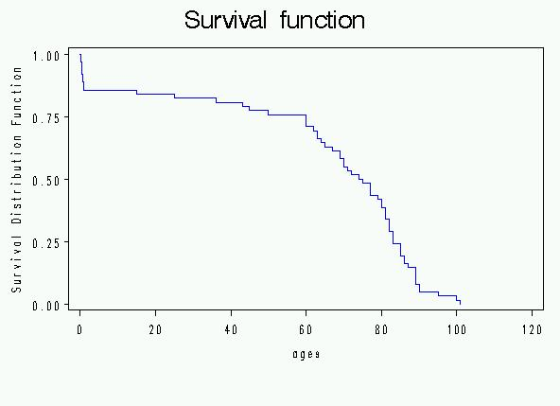
Cumulative survival
Same hypothetical data, plotted as cumulative distribution rather than density:
Recall pdf:

Slide 27
Cumulative survival
P(T>20)
P(T>80)

Slide 28
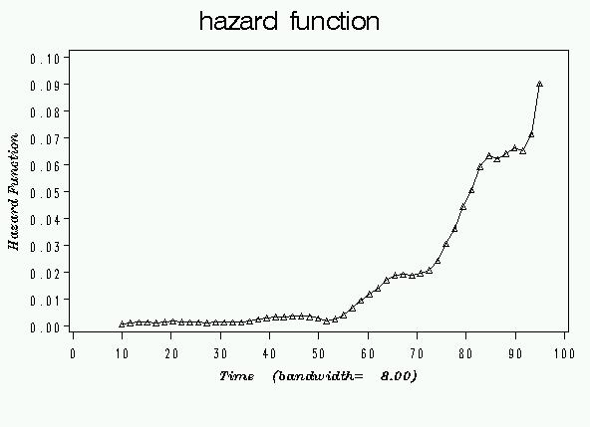
Hazard Function: new concept
Hazard rate is an instantaneous incidence rate.
AGES

Slide 29
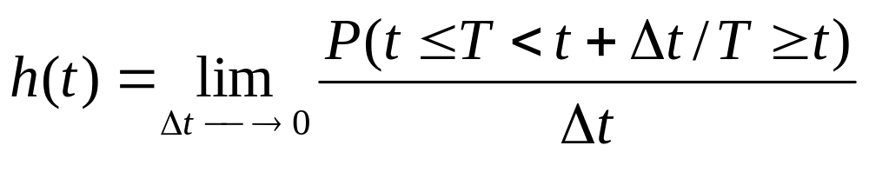
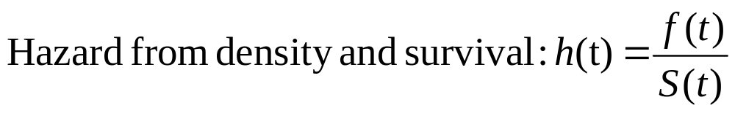
Hazard function
In words: the probability that if you survive to t, you will succumb to the event in the next instant.
Derivation (Bayes’ rule):

Slide 30
Hazard vs. density
This is subtle, but the idea is:
When you are born, you have a certain probability of dying at any age; that’s the probability density (think: marginal probability)
  Example: a woman born today has, say, a 1% chance of dying at 80 years.
However, as you survive for awhile, your probabilities keep changing (think: conditional probability)
  Example, a woman who is 79 today has, say, a 5% chance of dying at 80 years.

Slide 31
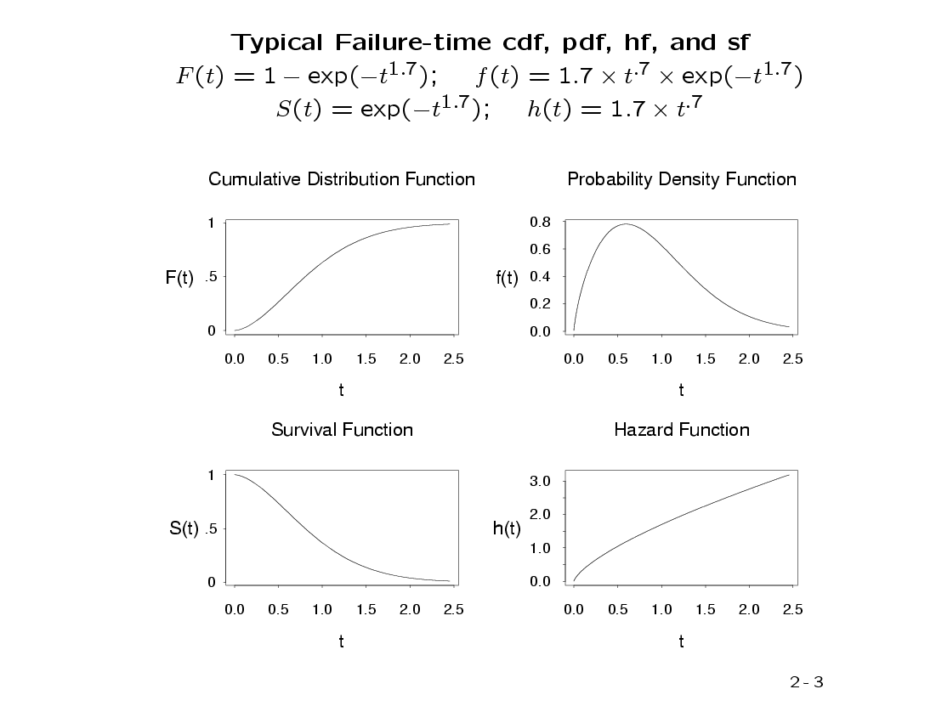
A possible set of probability density, failure, survival, and hazard functions.
f(t)=density function
F(t)=cumulative failure
S(t)=cumulative survival
h(t)=hazard function

Slide 32
A probability density we all know: the normal distribution
What do you think the hazard looks like for a normal distribution?
Think of a concrete example. Suppose that times to complete the midterm exam follow a normal curve.
What’s your probability of finishing at any given time given that you’re still working on it?

Slide 33
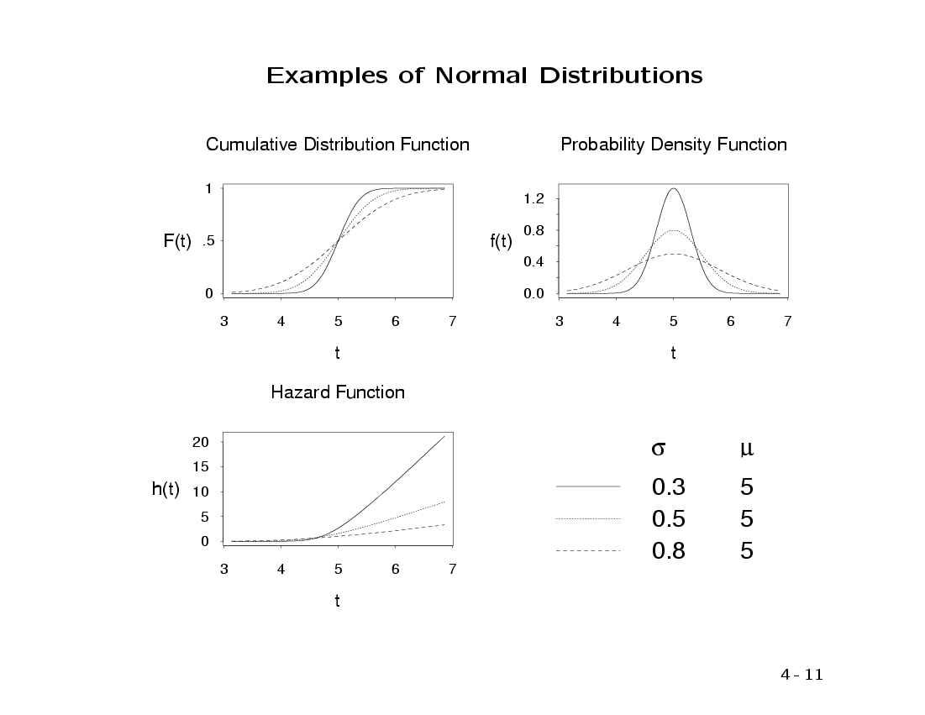
f(t), F(t), S(t), and h(t) for different normal distributions:

Slide 34
Examples: common functions to describe survival
Exponential (hazard is constant over time, simplest!)
Weibull (hazard function is increasing or decreasing over time)

Slide 35
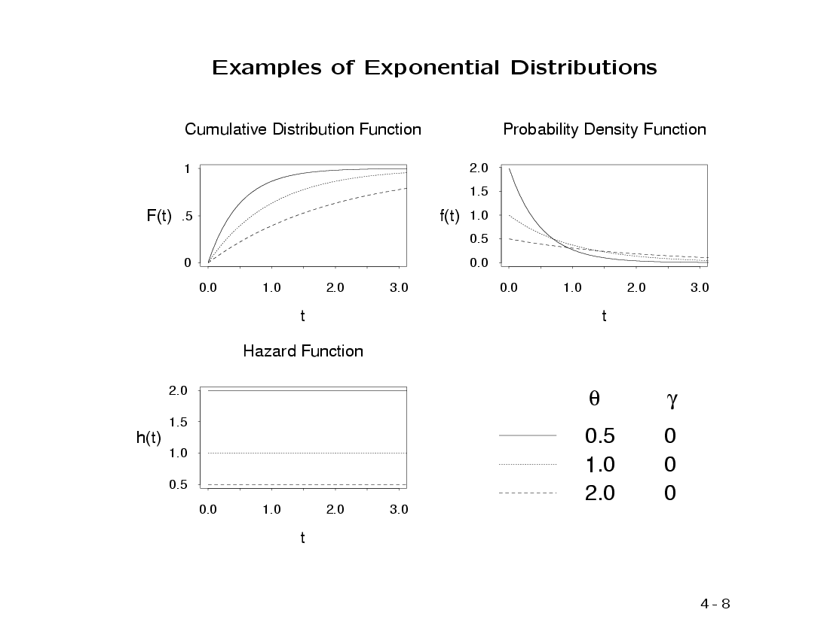
f(t), F(t), S(t), and h(t) for different exponential distributions:
λ

Slide 36
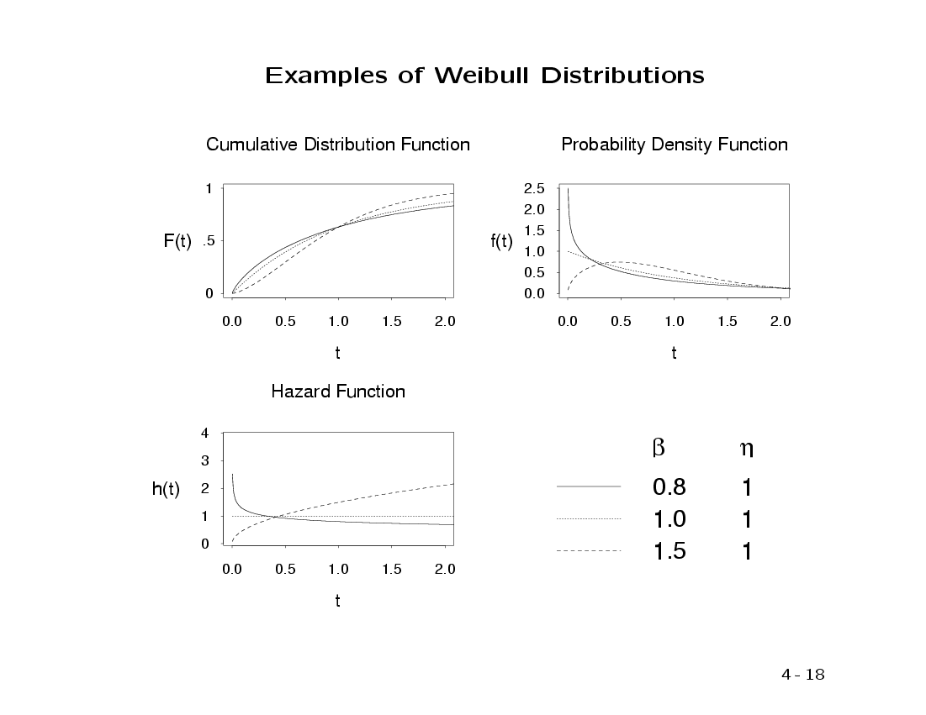
f(t), F(t), S(t), and h(t) for different Weibull distributions:
Parameters of the Weibull distribution

Slide 37
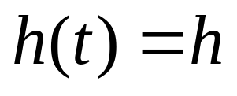
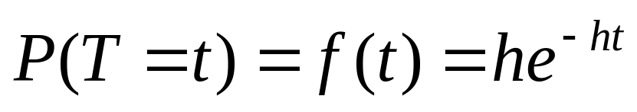
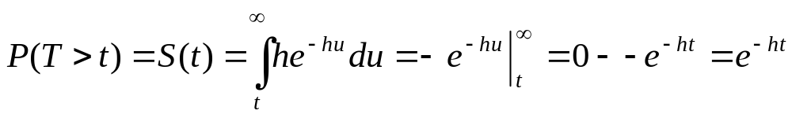
Exponential
Constant hazard function:
Exponential density function:
Survival function:

Slide 38
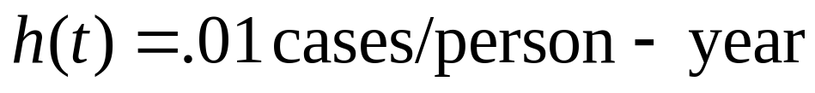
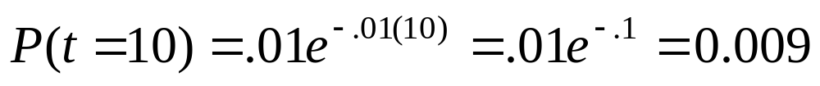
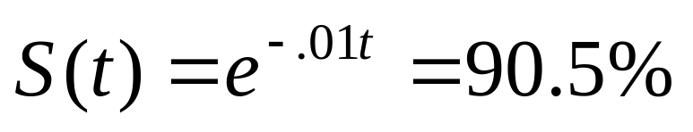
With numbers…
Why isn’t the cumulative probability of survival just 90% (rate of .01 for 10 years = 10% loss)?
Incidence rate (constant).
Probability of developing disease at year 10.
Probability of surviving past year 10.
(cumulative risk through year 10 is 9.5%)

Slide 39
Example…
Recall this graphic.
Does it look Normal, Weibull, exponential?

Slide 40
Example…
One way to describe the survival distribution here is:
P(T>76)=.01
P(T>36) = .16
P(T>20)=.20, etc.

Slide 41
Example…
Or, more compactly, try to describe this as an exponential probability function—since that is how it is drawn!
Recall the exponential probability distribution:
If T ~ exp (h), then
P(T=t) = he^{-ht}
Where h is a constant rate.
Here:
Event time, T ~ exp (Rate)

Slide 42
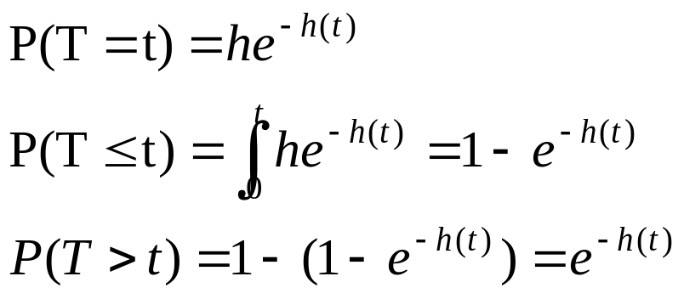
Example…
To get from the instantaneous probability (density), P(T=t) = he^{-ht}, to a cumulative probability of death, integrate:
Area to the left
Area to the right

Slide 43
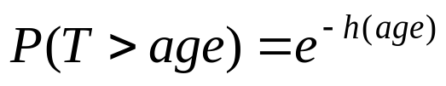
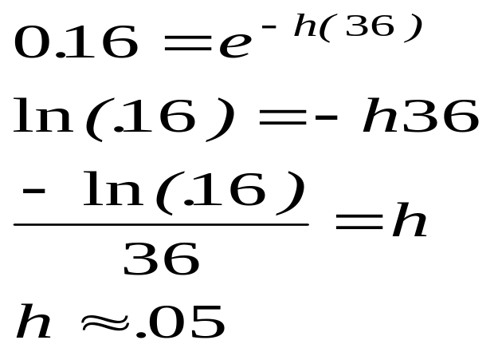
Example…
Solve for h:

Slide 44
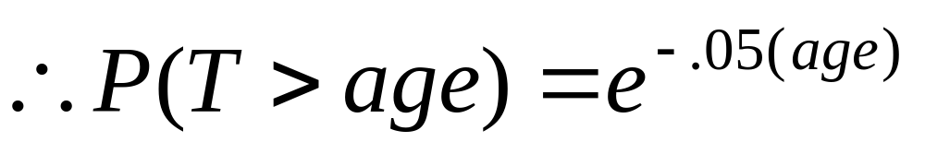
Example…
This is a “parametric” survivor function, since we’ve estimated the parameter h.

Slide 45
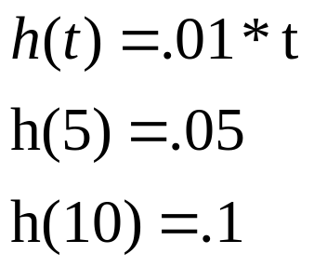
Hazard rates could also change over time…
Example: Hazard rate increases linearly with time.

Slide 46
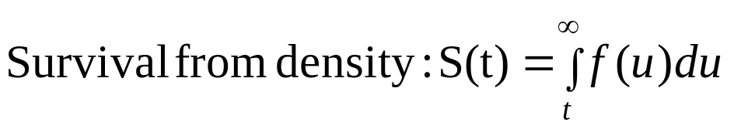
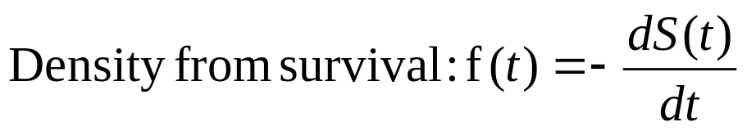
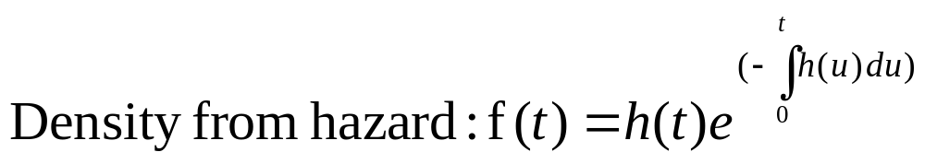
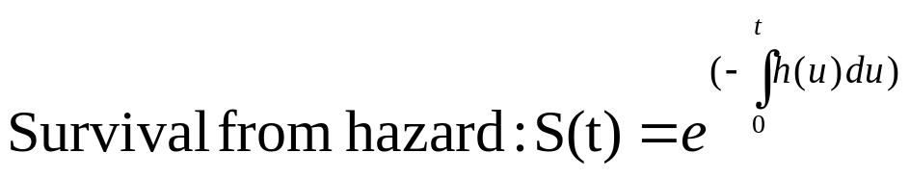
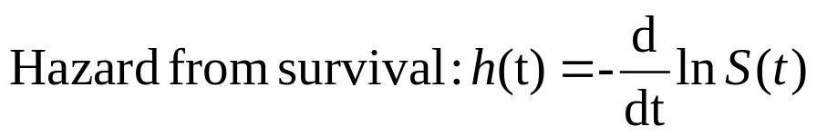
Relating these functions
(a little calculus just for fun…):
Notes:
If you know one, you can derive all the others.
We saw special case of 2 and 3 with exponential waiting times.

Slide 47
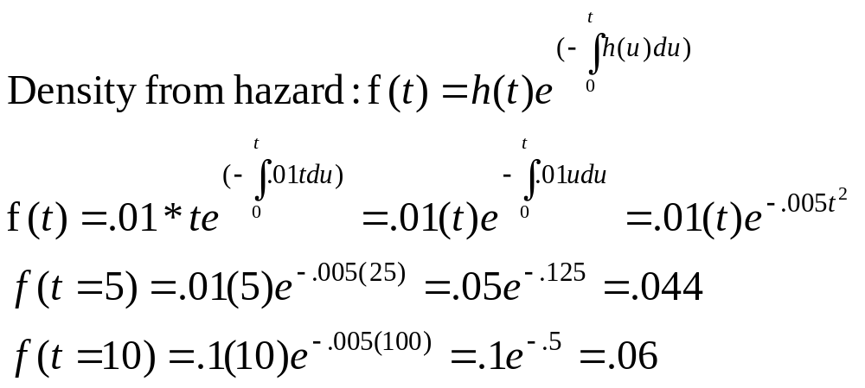
Getting density from hazard…
Example: Hazard rate increases linearly with time.

Slide 48
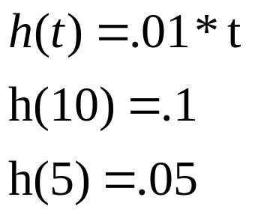
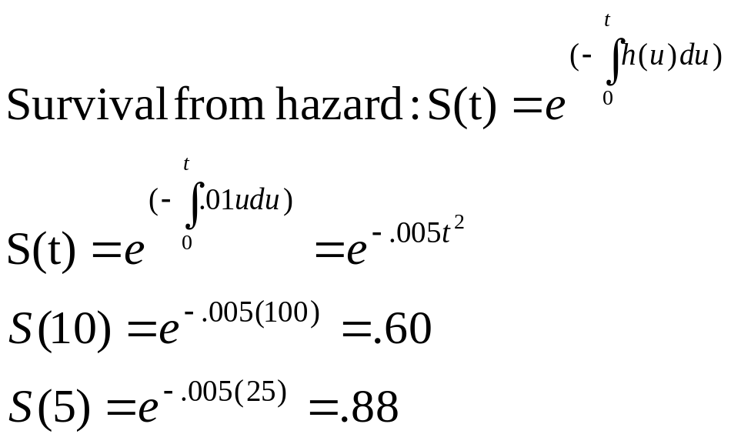
Getting survival from hazard…

Slide 49
Parametric regression techniques
Parametric multivariate regression techniques:
  Model the underlying hazard/survival function
  Assume that the dependent variable (time-to-event) takes on some known distribution, such as Weibull, exponential, or lognormal.
  Estimates parameters of these distributions (e.g., baseline hazard function)
  Estimates covariate-adjusted hazard ratios.
    A hazard ratio is a ratio of hazard rates
Many times we care more about comparing groups than about estimating absolute survival.

Slide 50
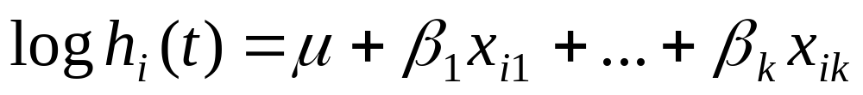
The model: parametric reg.
Components:
A baseline hazard function (which may change over time).
A linear function of a set of k fixed covariates that when exponentiated gives the relative risk.
Exponential model assumes fixed baseline hazard that we can estimate.
Weibull model models the baseline hazard as a function of time. Two parameters (shape and scale) must be estimated to describe the underlying hazard function over time.

Slide 51
The model
When exponentiated, risk factor coefficients from both models give hazard ratios (relative risk).
Components:
A baseline hazard function
A linear function of a set of k fixed covariates that when exponentiated gives the relative risk.

Slide 52
Cox Regression
Semi-parametric
Cox models the effect of predictors and covariates on the hazard rate but leaves the baseline hazard rate unspecified.
Also called proportional hazards regression
Does NOT assume knowledge of absolute risk.
Estimates relative rather than absolute risk.

Slide 53
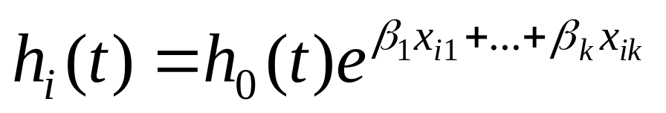
The model: Cox regression
Components:
A baseline hazard function that is left unspecified but must be positive (=the hazard when all covariates are 0)
A linear function of a set of k fixed covariates that is exponentiated. (=the relative risk)
Can take on any form

Slide 54
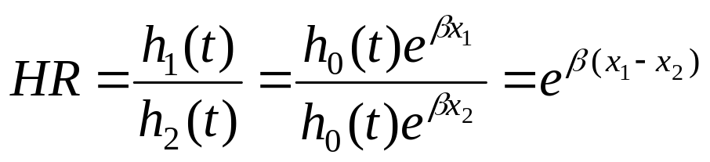
The model
The point is to compare the hazard rates of individuals who have different covariates:
Hence, called Proportional hazards:
Hazard functions should be strictly parallel.

Slide 55
Introduction to Kaplan-Meier
Non-parametric estimate of the survival function:
No math assumptions! (either about the underlying hazard function or about proportional hazards).
Simply, the empirical probability of surviving past certain times in the sample (taking into account censoring).

Slide 56
Introduction to Kaplan-Meier
Non-parametric estimate of the survival function.
Commonly used to describe survivorship of study population/s.
Commonly used to compare two study populations.
Intuitive graphical presentation.

Slide 57
Survival Data (right-censored)
Subject A
Subject B
Subject C
Subject D
Subject E
X
1. subject E dies at 4 months
Beginning of study
End of study
→ Time in months →

Slide 58
Corresponding Kaplan-Meier Curve
100%
Probability of surviving to 4 months is 100% = 5/5
Fraction surviving this death = 4/5
Subject E dies at 4 months
→ Time in months →

Slide 59
Survival Data
Subject A
2. subject A drops out after 6 months
Subject B
Subject C
3. subject C dies at 7 months
X
Subject D
Subject E
X
1. subject E dies at 4 months
Beginning of study
End of study
→ Time in months →

Slide 60
Corresponding Kaplan-Meier Curve
100%
Fraction surviving this death = 2/3
subject C dies at 7 months
→ Time in months →

Slide 61
Survival Data
Subject A
2. subject A drops out after 6 months
Subject B
4. Subjects B and D survive for the whole year-long study period
Subject C
3. subject C dies at 7 months
X
Subject D
Subject E
X
1. subject E dies at 4 months
Beginning of study
End of study
→ Time in months →

Slide 62
Corresponding Kaplan-Meier Curve
100%
Rule from probability theory:
P(A&B)=P(A)*P(B) if A and B independent
In survival analysis: intervals are defined by failures (2 intervals leading to failures here).
P(surviving intervals 1 and 2)=P(surviving interval 1)*P(surviving interval 2)
∴Product limit estimate of survival =
P(surviving interval 1/at-risk up to failure 1) *
P(surviving interval 2/at-risk up to failure 2)
= 4/5 * 2/3= .5333
→ Time in months →

Slide 63
The product limit estimate
The probability of surviving in the entire year, taking into account censoring
= (4/5) (2/3) = 53%
NOTE: > 40% (2/5) because the one drop-out survived at least a portion of the year.
AND <60% (3/5) because we don’t know if the one drop-out would have survived until the end of the year.

Slide 64
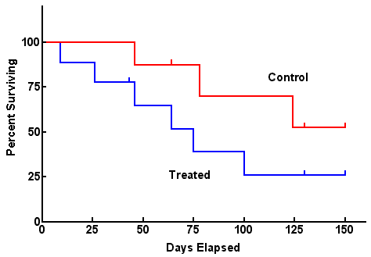
Comparing 2 groups
Use log-rank test to test the null hypothesis of no difference between survival functions of the two groups (more on this next time)

Slide 65
Caveats
Survival estimates can be unreliable toward the end of a study when there are small numbers of subjects at risk of having an event.

Slide 66
WHI and breast cancer
Women’s Health Initiative Writing Group. JAMA. 2002;288:321-333.
Small numbers left

Slide 67
Limitations of Kaplan-Meier
Mainly descriptive
Doesn’t control for covariates
Requires categorical predictors
Can’t accommodate time-dependent variables

Slide 68
All about Kaplan-Meier next lecture…

Slide 69
Overview of SAS PROCS
LIFETEST - Produces life tables and Kaplan-Meier survival curves. Is primarily for univariate analysis of the timing of events.
LIFEREG – Estimates regression models with censored, continuous-time data under several alternative distributional assumptions. Does not allow for time-dependent covariates.
PHREG– Uses Cox’s partial likelihood method to estimate regression models with censored data. Handles both continuous-time and discrete-time data and allows for time-dependent covariables

Slide 70
References
Paul Allison. Survival Analysis Using SAS. SAS Institute Inc., Cary, NC: 2003.

